Slide 1
From Prevention to Crisis: Mental Health Services & Opportunities
Community Networking Group Panel Discussion
October 26, 2017

Slide 2
Panelists
Jane Buffie
  Director of Clinical Services, Family Service Rochester
Mary Harders
  Mobile Crisis Practitioner, Crisis Response for SE Minnesota
Courtney Lawson
  Executive Director, NAMI Southeast Minnesota
Luke Mattheisen
  Coordinator, Crisis Response for Southeast Minnesota
Jim Schueller
  Sergeant, Olmsted County Sheriff Office
Megan Schueller
  Senior Forensic Social Worker, Adult Behavioral Health, Olmsted County Community Services

Slide 3
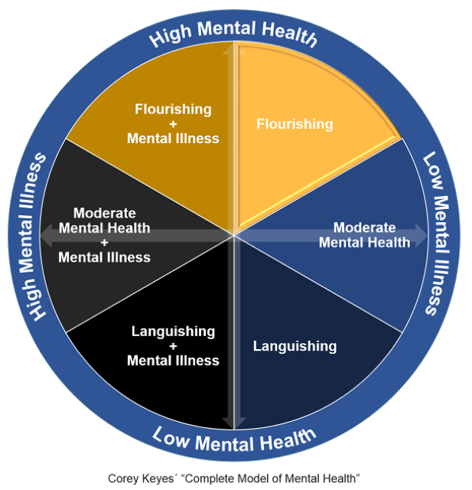
Mental Health Mental Illness
Recovery
Notes:
Add definitions

Slide 4
Addressing the Cycle
Flourishing mental health
Goal: maintenance
Prevention: education, awareness
Peer Support Services (NAMI Southeast Minnesota)
Counseling (Family Service Rochester)
Languishing mental health
Goal: recover flourishing mental health
Crisis care
  Phone/Mobile Crisis Response (Crisis Response of SE MN)
  Crisis Intervention Team (CIT)
Post-crisis resources
  Information and referral services (All)
  Peer support
  Counseling
Notes:
In order of severity of need
Speakers will speak in this order

Slide 5
Community Response &
Call to Action
Current efforts: some highlights
Sequential Intercept Model (CIT)
Crisis Stabilization Services (Crisis Response)
Dialectical Behavior Therapy (FSR)
Community Health Improvement Plan
Hope Intercept concept (NAMI SE MN)
How do you get involved?
LEARN! Mental Health First Aid (Adult and Youth)
Crisis Triage Center and Supportive Housing bonding bill

Slide 6
For More Information
Crisis Intervention Team model: http://www.cit.memphis.edu/aboutCIT.php
Crisis Response of Southeast Minnesota: http://crisis2southeastmn.com/
Family Service Rochester: http://familyservicerochester.org/
NAMI Southeast Minnesota: http://namisemn.org/
Community Health Improvement Plan: https://www.co.olmsted.mn.us/OCPHS
Mental Health First Aid registration: https://rochester.ce.eleyo.com/

